Slide 1

Assigning Tickets in Service NOW

Slide 2
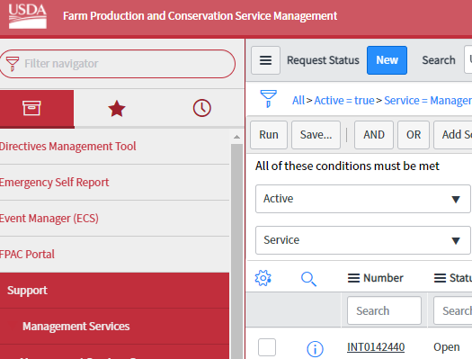
Customize Your Dashboard
Every morning and throughout the day customers create requests asking for services or products from MSD specialists. These tasks show as “open” in the status bar. First, let’s customize your ticket header to give you an easy view of tickets. This only needs to be done one time to configure your settings.
Open Management Service Queue, this will show all of the tickets for MSD.
Click on the gear symbol near the top left side of the screen under “Service”

Slide 3
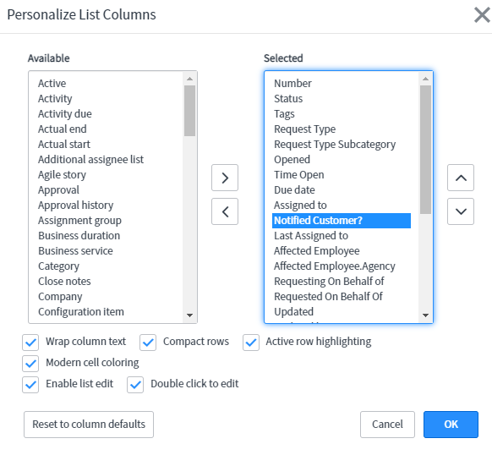
Customize Your Dashboard (Cont.)
3. Add the following filters to your dashboard by selecting in the left pane to move to the right pane. In this order add: Number, Status, Request Type, Request Type Subcategory, opened, Time Open, Due Date, Assigned to, and Notified Customer?

Slide 4
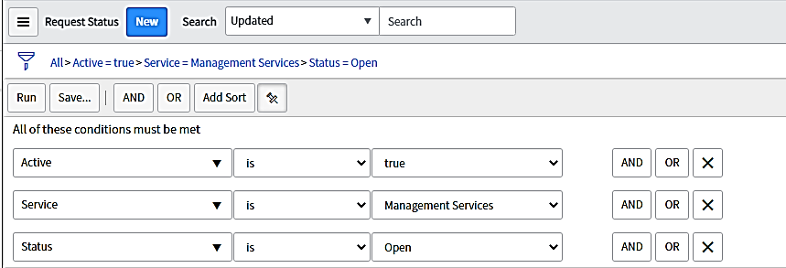
Create Filter to View All “Open” Tasks
To easily find the “open” tickets you can sort to display only the open tickets. On the Management Service Queue Page use the following filters and the Click Run. 1. Change to the same filters in Step 1.
2. Change to the Same filters in 2.
3. Select Run in 3.
3
2
1

Slide 5
Reference List: Specialists To Assign Tasks Based on Request Type
Request Type | Assignee
BMB Budget (Lease advertisement is also budget) | Kendra Tyler - Queue
MSD HR | My Anderson
Access Request-SAAR | My Anderson
Parking Request | Nichell McMiller
Conference Room | Nichell McMiller
MSD Customer Service | Nichell McMiller
BMB Other | Depends on request
DFRMB | Catherine Cole -Queue
LAAB | Caitlin Cunningham -Queue
PPMB- Fleet Management | Adam Stiegelmeier -Queue
PPMB-Personal Property | Vernee Wilson -Queue
SFMB DC (Except for FSA-159 forms) | Kim Deal -Queue
SFMB Raleigh --Building Issues | Nathan Dean
Mail Management | Samuel Johnson (DC) except when subcategory other than postage stamp AND the location is not DC- assign to Ralph Garcia
Printing (depends on request-- Envelopes, Pitney Bowes, DC Paper request) | Samuel Johnson (DC)
Printing (depends on request-- News Paper Print, KC Paper request) | Brian Smith (KC)
Safety | Marshall Jean

Slide 6
Assigning An Open Task
Open the ticket by clicking the ticket number
Confirm the “Request Type” the customer selected is accurate based on the description. Make changes if needed.
If Assigning to the following managers leave Assignment Group as: FPAC - MS - Management Services Queue
Kendra, Kim Deal, Adam, Vernee, Caitlin, Catherine
If assigning to any other regular specialist change the Assignement Group to: FPAC - MS - Management Services Fulfillers

Slide 7
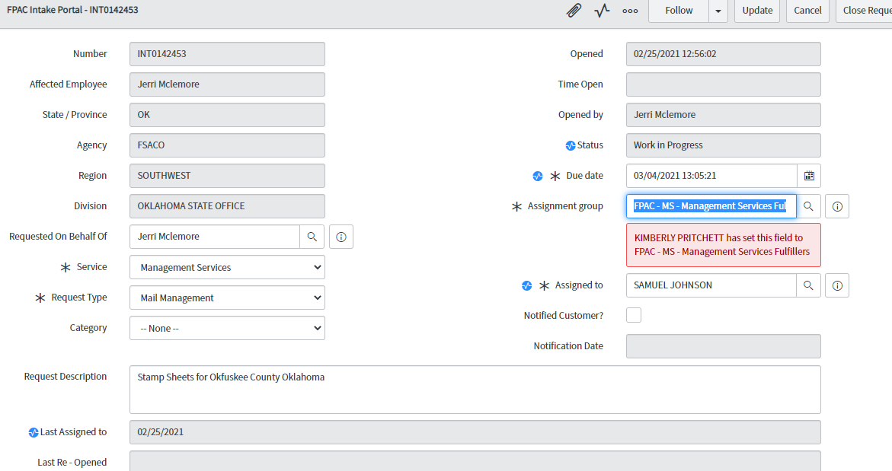
Assigning An Open Task
When assigning the ticket to a specialist you must have all fields with an asterisk (*) completed in order to save using (UPDATE).
For the (DUE DATE) pick any day a week away.
In this example see how the request type is Mail Management. Sam Johnson is assigned by changing the assignment group and then his name is put in the Assigned to.
Select Update when finished.

Slide 8
Ticket Assignment Expectations
This is a first priority since only through customer service assigning tasks do msd employees receive their work.
This should be completed:
First thing in the morning
Through the day
Any tickets created on that day should be assigned COB.
If you need help or are unsure about assigning tickets in the (WORK NOTES) use @ and my name Nichell.McMiller to message me about the ticket in question and I will be alerted.

